Slide 1


CitationProfileR
SDS Capstone Project,
sponsored by Dr Lukas Wallrich

Slide 2





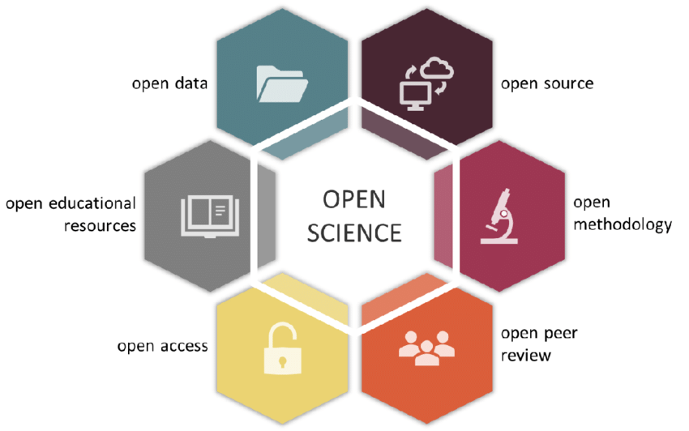

About me
https://www.lukaswallrich.coffee/
Notes:
Associate Professor

Slide 3
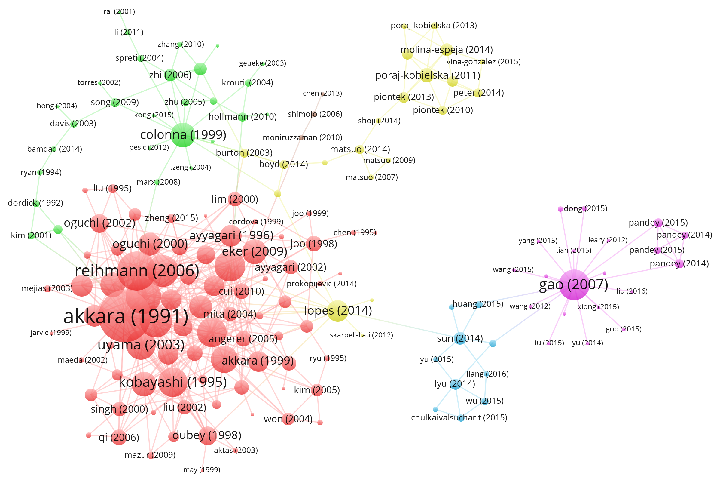
Citations matter …
Notes:
How ideas flow
How contributions are recognised

Slide 4

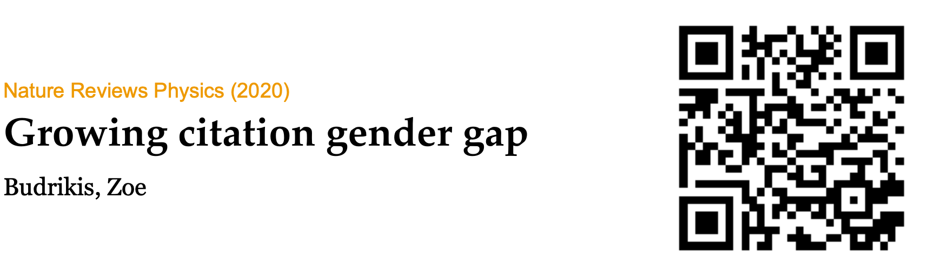


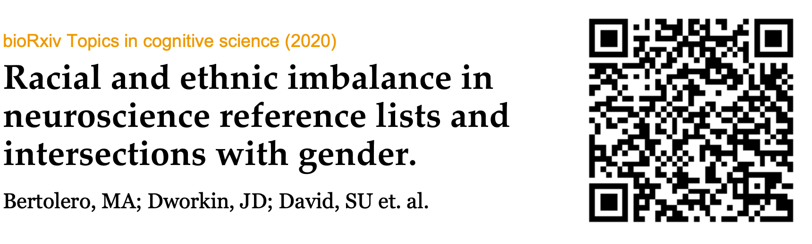
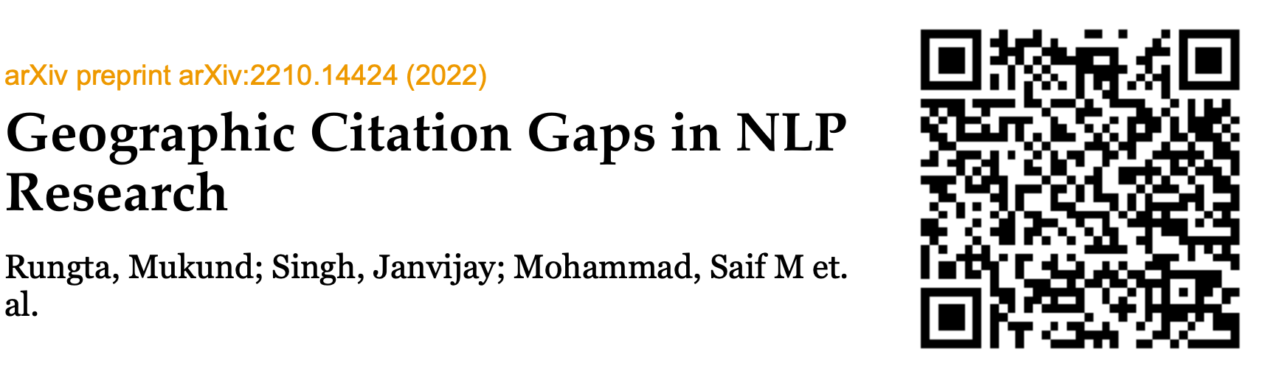

… but there are multiple citation gaps
Notes:
Perpetuates disadvantage
Harms science

Slide 5
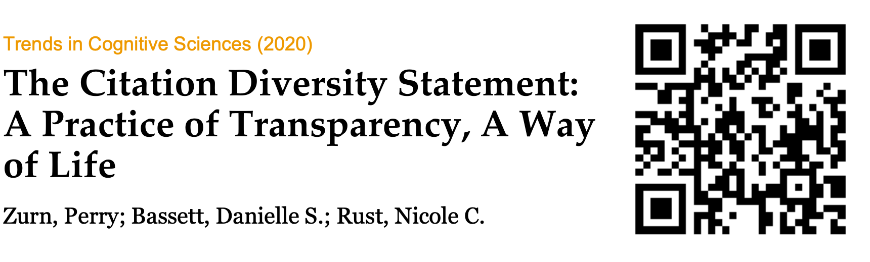
A proposed remedy
Currently limited to gender
Time consuming to create, so rarely requested

Slide 6
CitationProfileR
Enable authors, reviewers and meta-researchers to explore citation diversity in manuscripts
Extract manuscript citations
Classify them using web APIs
Create visualization and report

Slide 7
Why join this project?
Address an important problem
Produce open-source tool, and become co-author on publication
Practice a good range of skills:
PDF data extraction
Use of multiple APIs
Web app (e.g., Shiny) design
Reuse of existing Python code

Slide 8
CitationProfileR
SDS Capstone Project
https://www.lukaswallrich.coffee/

